Slide 1

现代通信光电子学
第12章：自相位调制与交叉相位调制
电子科技大学信息与通信工程学院
2018-2019秋季学期

Slide 2
Self-Phase Modulation
SPM-Induced Spectral Changes
Effect of Group-Velocity Dispersion
Higher-Order Nonlinear Effects

Slide 3






SPM-Induced Spectral Changes
The GVD effects are negligible for relatively wide pulses with a large peak power L_{D}>>L>L_{NL}
Using and equating the real and imaginary parts

Slide 4







SPM-Induced Spectral Changes
SPM gives rise to an intensity-dependent phase shift but the pulse shape remains unaffected. The maximum phase shift occurs at the pulse center located at T = 0 ( ).

Slide 5

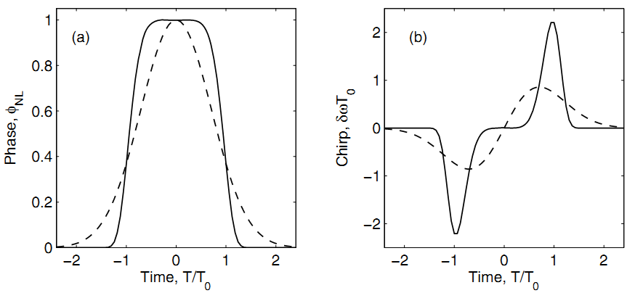
SPM-Induced Spectral Changes
Spectral changes induced by SPM are a direct consequence of the time dependence of nonlinear phase shift.
Super-Guassian
Super-Guassian
Guassian
Guassian
The temporal variation of nonlinear phase shift is similar to that of the pulse intensity.

Slide 6
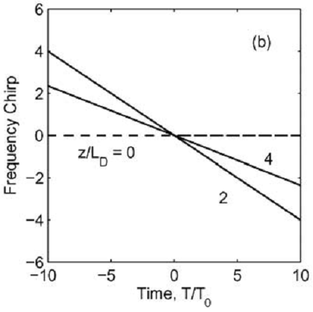
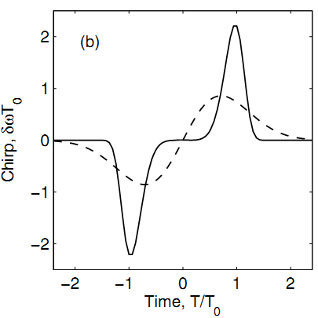
SPM-Induced Spectral Changes
New frequency components are generated continuously as the pulse propagates down the ﬁber. These SPM-generated frequency components broaden the spectrum over its initial width.
To compare two cases.

Slide 7
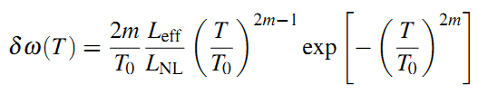
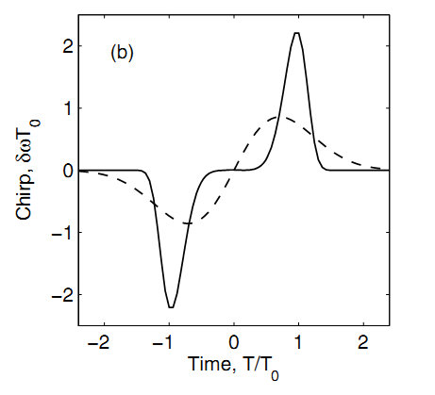
SPM-Induced Spectral Changes
The qualitative features of frequency chirp depend on the pulse shape. For a unchirped super-Gaussian pulse, the SPM-induced chirp is
δω is negative near the leading edge (a red shift) and becomes positive near the trailing edge (a blue shift) of the pulse;
The chirp is considerably larger for pulses with steeper leading and trailing edges;
Super-Gaussian pulses behave differently than Gaussian pulses because the chirp occurs only near pulse edges and does not vary in a linear fashion.
Super-Guassian
Guassian

Slide 8


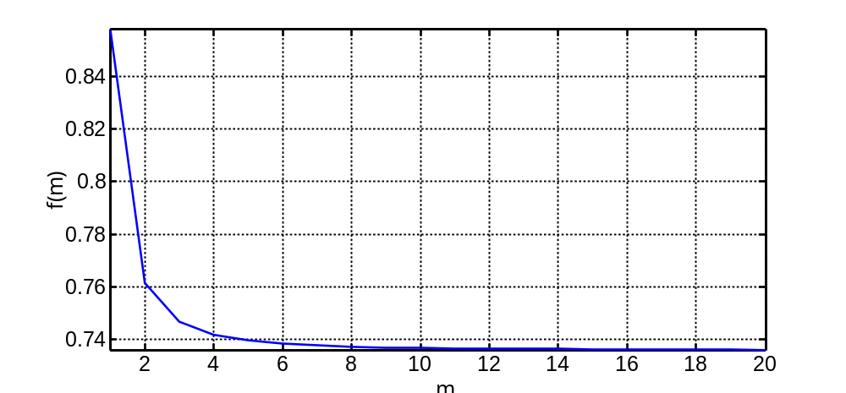

SPM-Induced Spectral Changes
The SPM-induced chirp can produce spectral broadening or narrowing depending on how the input pulse is chirped. For a unchirped super-Gaussian pulse
For an unchirped Gaussian pulse
For an intense ultrashort pulses, the broadening factor can be larger than 100.

Slide 9


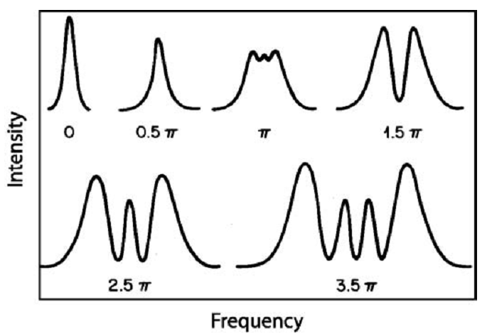
SPM-Induced Spectral Changes
The actual shape of the pulse spectrum is found by taking the Fourier transform of the normalized amplitude and using
In general, the spectrum depends not only on the pulse shape but also on the initial chirp imposed on the pulse.

Slide 10
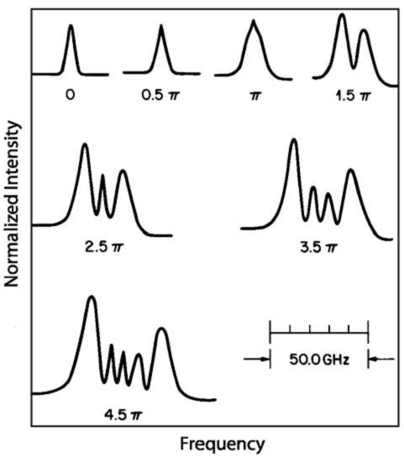

SPM-Induced Spectral Changes
The asymmetry seen in the experimental traces can be attributed to the asymmetric shape of the incident pulse.
SPM-induced spectral broadening is accompanied by an oscillatory structure covering the entire frequency range.
The outermost peaks are the most intense.
The number of peaks depends on the maximum phase shift and increases linearly with it.
Experimentally observed spectra for a nearly Gaussian pulse at the output of a 99-m-long ﬁber.

Slide 11



SPM-Induced Spectral Changes
To obtain a more accurate measure of spectral broadening, one should use the RMS spectral width deﬁned as
Where
The spectral broadening factor for a Gaussian pulse is given by

Slide 12
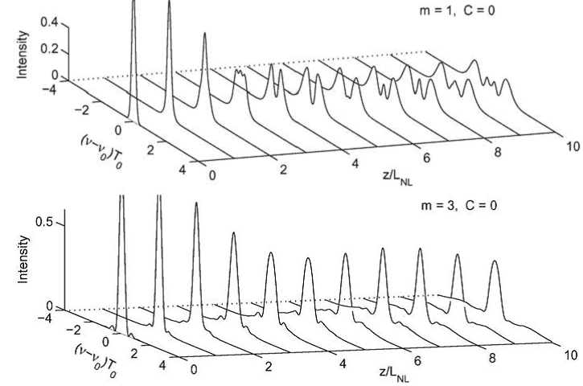
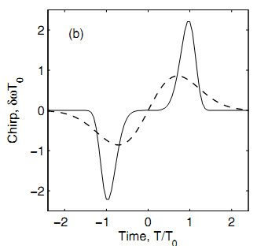
Effect of Pulse Shape and Initial Chirp
The shape of the SPM-broadened spectrum depends on the pulse
shape, and on the initial chirp.
Fiber losses are ignored.

Slide 13
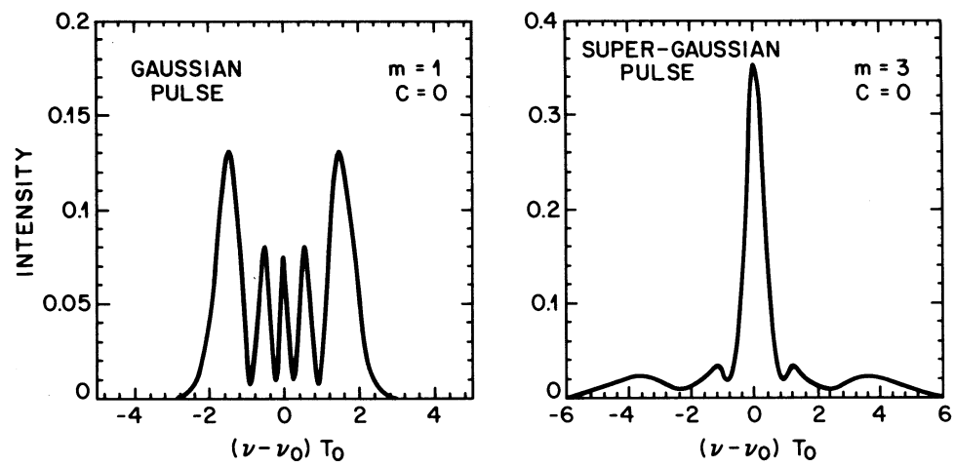

Effect of Pulse Shape and Initial Chirp
The spectral range of the super-Gaussian pulse is about three times larger than that of the Gaussian pulse, as we discussed before
Most of the energy remains in the central peak for the SG pulse, because the chirp is nearly zero over the center. The frequency chirp occurs mainly near both edges. As these edges become steeper, the tails extend over a longer frequency range, but at the same time, carry less energy because chirping occurs over a small time duration.

Slide 14
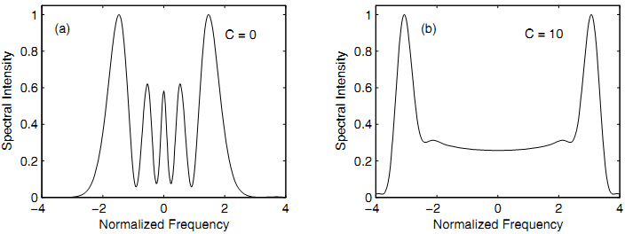
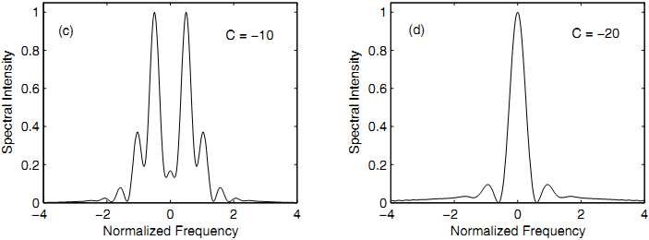
Effect of Pulse Shape and Initial Chirp
An initial frequency chirp can also lead to drastic changes in the SPM-broadened pulse spectrum.
For C > 0, spectral broadening increases and the oscillatory structure becomes less pronounced.
A negatively chirped pulse undergoes spectral narrowing through SPM.

Slide 15


Effect of Pulse Shape and Initial Chirp
Noting that the SPM-induced phase shift is linear and positive (frequency increases with increasing T) over the central portion of a Gaussian pulse, Thus, it adds with the initial chirp for C > 0, resulting in an enhanced
oscillatory structure. In the case of C < 0, the two chirp contributions are of opposite signs (except near the pulse edges), and the pulse becomes less chirped.
Super-Guassian
Super-Guassian
Guassian
Guassian

Slide 16
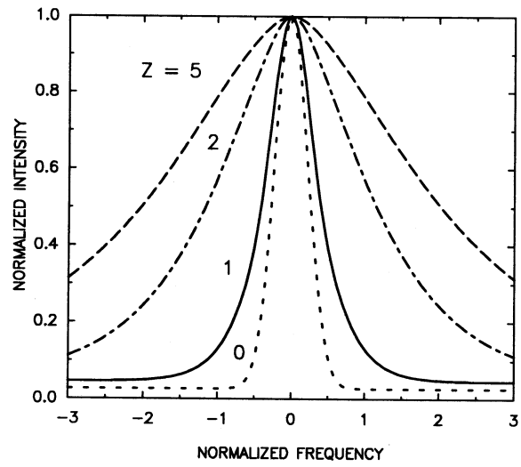

Effect of Partial Coherence
In the case of a CW beam, SPM can lead to spectral broadening during its propagation inside an optical ﬁber. It is because partially coherent light exhibits both intensity and phase ﬂuctuations. The SPM converts intensity ﬂuctuations into additional phase ﬂuctuations. Alternatively, SPM reduces the coherence time T_{c}.
A multipeak structure is absent.

Slide 17
Self-Phase Modulation
SPM-Induced Spectral Changes
Effect of Group-Velocity Dispersion
Higher-Order Nonlinear Effects

Slide 18





Effect of Group-Velocity Dispersion
In the anomalous-dispersion regime of an optical ﬁber, the two phenomena can cooperate in such a way that the pulse propagates as an optical soliton; In the normal-dispersion regime, the combined effects of GVD and SPM can be used for pulse compression.
N governs the relative importance of the SPM and GVD effects on pulse evolution along the ﬁber.

Slide 19
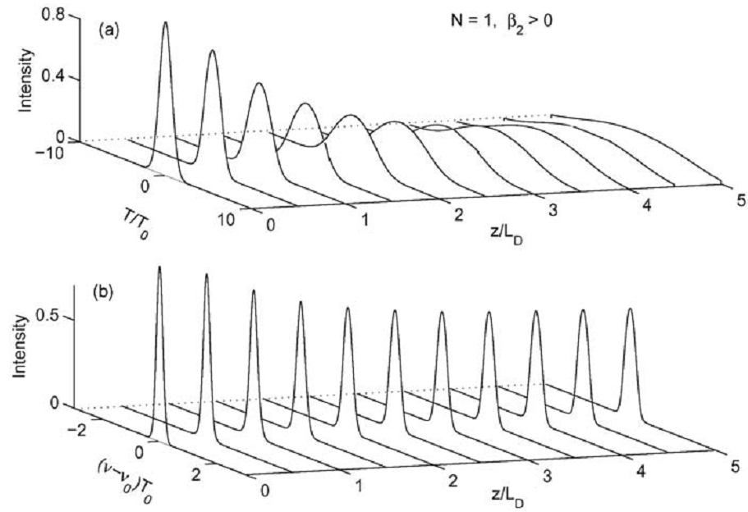


Effect of Group-Velocity Dispersion
The pulse broadens much more rapidly compared with the N = 0 case, because of red-shifted near the leading edge and blue-shifted near the
trailing. Note that the SPM-induced phase shift becomes less.

Slide 20
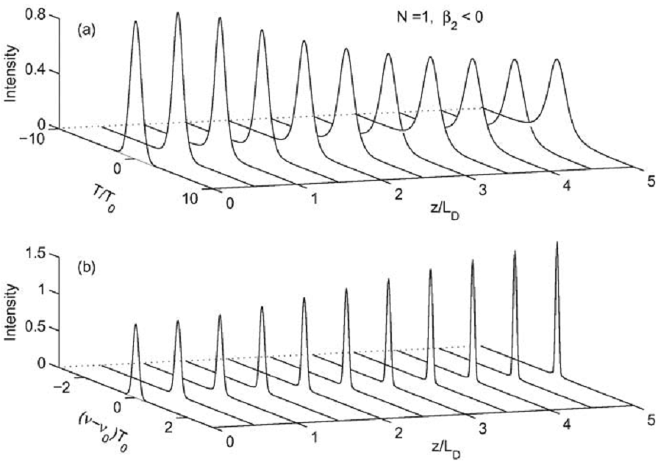
Effect of Group-Velocity Dispersion
The pulse broadens initially at a rate much lower than that in the absence of SPM and then appears to reach a steady state for z > 4L_{D}. The spectrum narrows rather than exhibiting broadening expected by SPM in the absence of GVD.

Slide 21


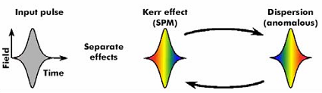

Effect of Group-Velocity Dispersion
Noting that the SPM-induced chirp has opposite sign compared with the dispersion-induced chirp while β₂ < 0.
The two chirp contributions nearly cancel each other along the
center portion of the Gaussian pulse when L_{D} = L_{NL}.
Pulse shape adjusts itself during propagation to make such cancelation as complete as possible. Thus, GVD and SPM cooperate with each other to maintain a chirp-free pulse. Initial broadening of the Gaussian pulse occurs because the Gaussian proﬁle is not the characteristic shape associated with a fundamental soliton. (Sech pulse is the one)

Slide 22
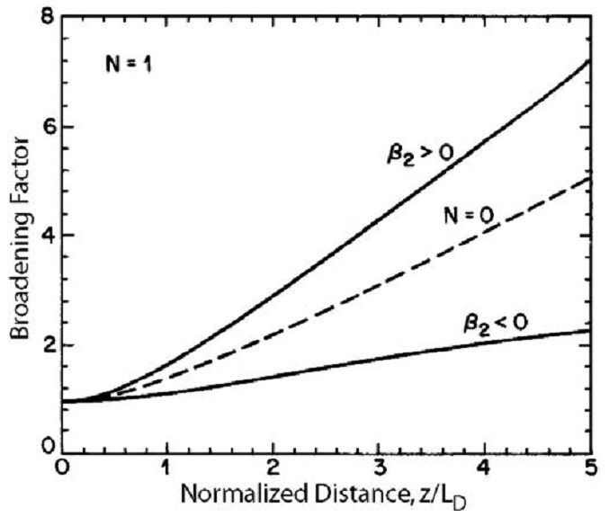
Broadening Factor
Broadening factor of unchirped Gaussian pulses in the cases of normal and anomalous.

Slide 23




Broadening Factor
The performance of certain optical communication systems by increasing the peak power of input pulses to the proper level.
When an unchirped Gaussian pulse is incident at the input end of a ﬁber of length L, the broadening factor is given by
SPM can be viewed as a four-wave mixing process in which two photons at pump frequencies are annihilated to create two photons at frequencies shifted toward the blue and red sides.

Slide 24
Self-Phase Modulation
SPM-Induced Spectral Changes
Effect of Group-Velocity Dispersion
Higher-Order Nonlinear Effects

Slide 25
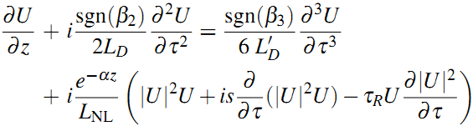



Higher-Order Nonlinear Effects
Self-steepening
Intrapulse Raman scattering
Both of these effects are quite small for picosecond pulses but must be considered for ultrashort pulses with T₀ < 1 ps.

Slide 26





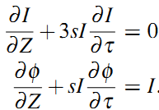
Self-Steepening
Self-steepening results from the intensity dependence of the group velocity, and it leads to an asymmetry in the SPM-broadened spectra of ultrashort pulses.

Slide 27



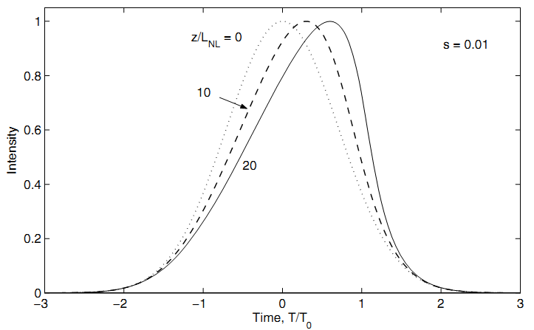
Self-Steepening
f (τ) describes the pulse shape at z = 0. Each point τ moves along a straight line from its initial value, and the slope of the line is intensity dependent. This feature leads to pulse distortion. For a Gaussian pulse:
The group velocity of the pulse is intensity dependent such that the peak moves at a lower speed than the wings.

Slide 28





Self-Steepening
Self-steepening of the pulse eventually creates an optical shock. The
distance at which the shock is formed is obtained by requiring that
∂ I/∂τ be inﬁnite at the shock location.
A similar relation holds for a “sech” pulse with only a slight change in the numerical coefﬁcient (0.43 in place of 0.39).
Optical shocks with an inﬁnitely sharp trailing edge never occur in practice because of the GVD. The shock distance z_{s} is also affected by ﬁber losses α; In the dispersionless case, ﬁber losses delay the formation of optical shocks; if αz_{s} > 1, the shock does not develop at all.

Slide 29


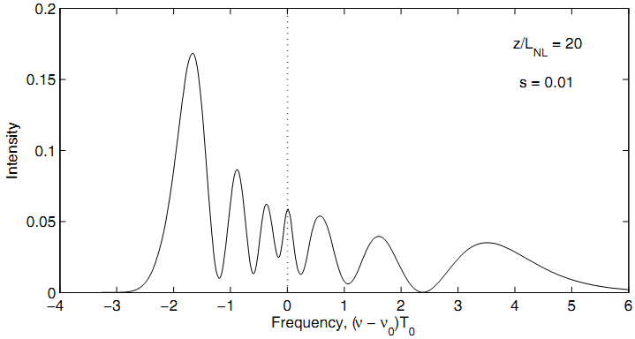

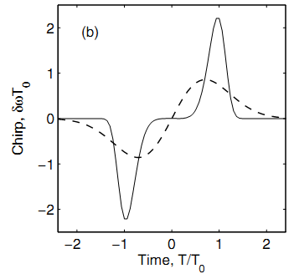
Self-Steepening
Self-steepening also affects SPM-induced spectral broadening.

Slide 30
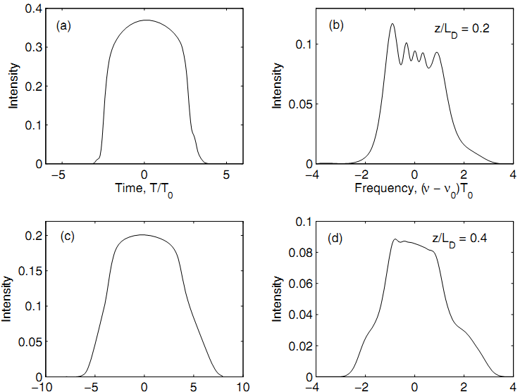
Effect of GVD on Optical Shocks
An initially unchirped Gaussian pulse propagating with normal dispersion and without TOD.

Slide 31
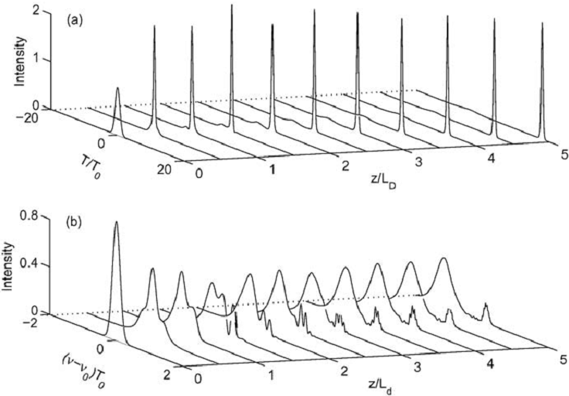
Intrapulse Raman Scattering
An initially unchirped Gaussian pulse in the anomalous-dispersion regime.
As the pulse spectrum shifts through the RIFS, pulse slows down.

Slide 32
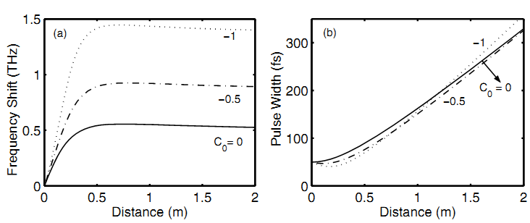
Intrapulse Raman Scattering
In the case of normal dispersion, both the spectral and temporal shifts are reduced considerably because of a rapid dispersion-induced broadening of the input pulse.
The saturation of the spectral shift is related to pulse broadening, and it can be increased by chirping Gaussian pulses such that β₂C < 0, because such chirped Gaussian pulses go through an initial compression phase before they broaden rapidly.

Slide 33
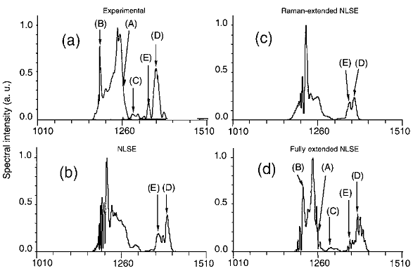


Intrapulse Raman Scattering

Slide 34
Cross-Phase Modulation
XPM-Induced Nonlinear Coupling
XPM-Induced Modulation Instability
Spectral and Temporal Effects
Applications of XPM

Slide 35




XPM-Induced Nonlinear Coupling
From a physical perspective, XPM occurs because the effective refractive index seen by an optical beam in a nonlinear medium depends not only on the intensity of that beam but also on the intensity of other co-propagating beams.
In the quasi-monochromatic approximation, we separate the rapidly varying part of the electric ﬁeld by writing it in the form
Where
Four wave mixing.

Slide 36




XPM-Induced Nonlinear Coupling
The nonlinear part of the refractive index is given by ( j = 1,2)
Assuming that the nonlinear effects do not affect significantly the ﬁber modes, optical ﬁelds can be expressed as
The resulting propagation equation becomes
Where
In single-mode ﬁbers, the differences among the overlap integrals is small, sometimes can be neglected in practice.

Slide 37
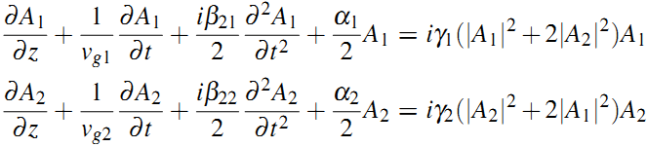




XPM-Induced Nonlinear Coupling
Then the propagation equation can be written as
Where
Generally, the two pulses not only have different GVD coefﬁcients but also propagate at different speeds because of the difference in their group velocities. The group-velocity mismatch plays an important role because it limits the XPM interaction as pulses separate from each other. For that reason one can deﬁne the walk-off length L_{W}.

Slide 38
Cross-Phase Modulation
XPM-Induced Nonlinear Coupling
XPM-Induced Modulation Instability
Spectral and Temporal Effects
Applications of XPM

Slide 39




Modulation Instability
Many nonlinear systems exhibit an instability that leads to modulation of the steady state as a result of an interplay between the nonlinear and dispersive effects. Consider propagation of one CW beam inside an optical ﬁber and ignore losses, the propagation equation takes the form
Assuming that A(z,T) remains time independent during propagation inside the ﬁber, the steady-state solution can be obtained as
(Only a change of phase)
However, we assume that the steady-state is perturbated
K and Ω are the wave number and the frequency of perturbation.

Slide 40


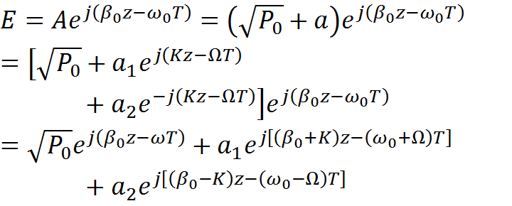
Modulation Instability
The set of two homogeneous equations for a₁ and a₂ has a nontrivial solution only when K and Ω satisfy the following dispersion relation
The dispersion relation shows that steady-state stability depends critically
on whether light experiences normal or anomalous GVD inside the ﬁber.
In the case of normal GVD, the wave number K is real for all Ω, and the steady state is stable against small perturbations.
Because a₁ and a₂ are much smaller than P₀, the two spectral sidebands can be neglect in this case.

Slide 41
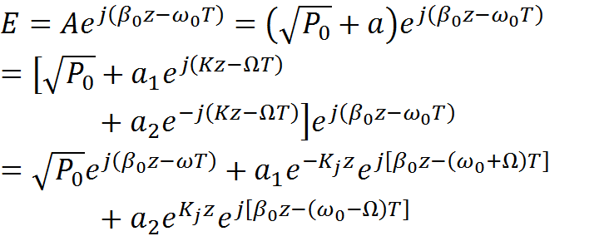

Modulation Instability
In the case of anomalous GVD, K becomes imaginary for |Ω|<Ω_{c}, and the perturbation a(z,T) grows exponentially with z.
This instability is referred to as modulation instability because it leads to a spontaneous temporal modulation of the CW beam and transforms it into a pulse train.

Slide 42


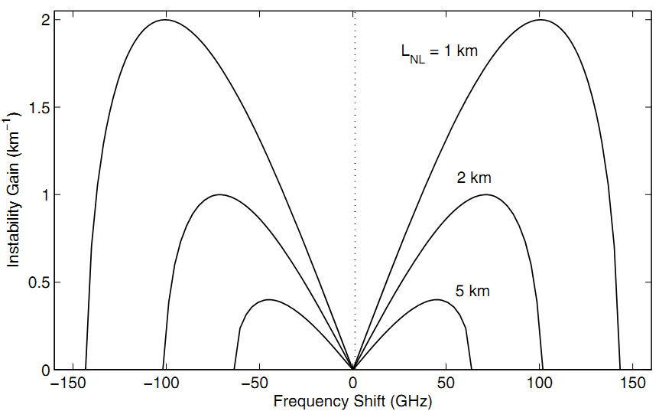



Gain Spectrum
(Power Gain)
The gain exists only if |Ω| < Ω_{c}. The peak gain does not depend on β₂.

Slide 43
Gain Spectrum
When the fiber loss is considered, modulation instability still occurs as long as αL_{NL} < 1;
The third-order dispersion β₃ (or any odd-order dispersive term) does not affect the gain spectrum of modulation instability;
Modulation instability can be interpreted in terms of a four-wave-mixing process that is phase-matched by SPM. If a probe wave at a frequency ω₁ =ω₀ +Ω were to copropagate with the CW beam at ω₀, it would experience a net power gain given as long as |Ω| < Ω_{c};
Even when the pump wave propagates by itself, modulation instability can lead to spontaneous breakup of the CW beam into a periodic pulse train (T_{m} = 2π/Ω_{max}). Noise photons (vacuum ﬂuctuations) act as a probe in this situation and are ampliﬁed by the gain provided by modulation instability.

Slide 44



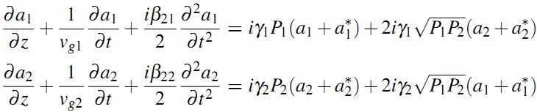
Linear Stability Analysis
Similar to the single-beam case, modulation instability is expected to occur in the anomalous-GVD region of the ﬁber for the two-beam case. The main issue is whether XPM-induced coupling can destabilize the CW state even when one or both beams experience normal GVD.
In the CW propagation equation, the steady-state solution is obtained by setting the time derivatives to zero. If ﬁber losses are neglected, the solution is of the form
Stability of the steady state is examined assuming a time-dependent solution of the form
The perturbations satisfy the following set of coupled linear equations

Slide 45



Linear Stability Analysis
The preceding set of linear equations has the following general solution
The set of four homogeneous equations for u₁, u₂, v₁, and v₂ has a nontrivial solution only when the perturbation satisﬁes the following dispersion relation
Where
The steady-state solution becomes unstable if the wave number K has an imaginary part for some values of Ω. In the absence of XPM coupling term, the analysis applies to each wave independently.

Slide 46

Linear Stability Analysis
In the presence of XPM coupling, the dispersion relation provides a fourth-degree polynomial in K whose roots determine the conditions under which K becomes complex. When the group-velocity mismatch is negligible, the four roots are given by
K can become complex only if C_{XPM} > f₁f₂, so the condition for modulation instability to occur can be written as
Where
The gain spectrum of modulation instability is obtained from g(Ω)= 2Im(K).
Note: modulation instability can occur irrespective of the signs of the GVD coefﬁcients. The smallest frequency range corresponds to the case in which both beams are in the normal-dispersion regime of the ﬁber, because modulation instability in that case is due solely to XPM.

Slide 47




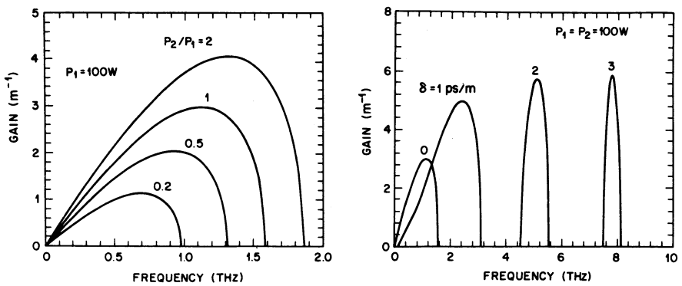
Linear Stability Analysis
These results show that XPM-induced modulation instability can occur in the normal-GVD regime for relatively small values of δ. The peak gain of about 5 m⁻¹ at the 100-W power level implies that the instability can develop in ﬁbers a few meters long.
This technique has been used to generate a pulse train from a CW light.

Slide 48
Cross-Phase Modulation
XPM-Induced Nonlinear Coupling
XPM-Induced Modulation Instability
Spectral and Temporal Effects
Applications of XPM

Slide 49
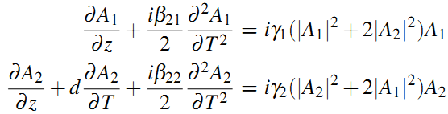


Spectral and Temporal Effects
Assuming two copropagating pulses with nonoverlapping spectra, and the polarization effects as well as losses are ignored. The coupled NLS can be written as
Where
We also define

Slide 50


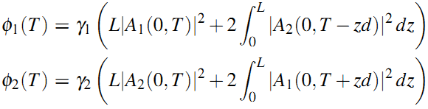



Asymmetric Spectral Broadening
For L << L_{D}, the second-derivative terms can be neglected. The group-velocity mismatch is included through the parameter d assuming L_{W} < L. The general solution is given by
Consider the case of two unchirped Gaussian pulses of the same width with the initial amplitudes

Slide 51



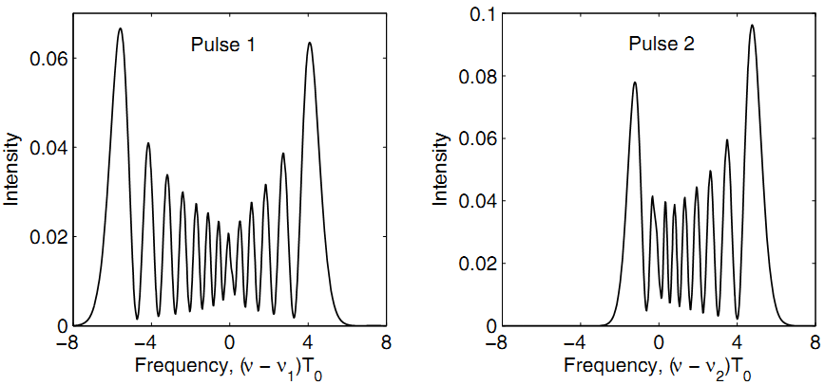




Asymmetric Spectral Broadening
The time dependence of the phase manifests as spectral broadening.

Slide 52

Asymmetric Spectral Broadening
For positive values of δ, the chirp is larger near the leading edge for pulse 1 while the opposite occurs for pulse 2. Because the leading and trailing edges carry red- and blue-shifted components, respectively, the spectrum of pulse 1 is shifted toward red while that of pulse 2 is shifted toward blue.
To consider the pump-probe conﬁguration assuming P₁<<P₂. The pump-induced chirp imposed on the probe pulse is obtained by neglecting the SPM contribution and is of the form
Therefore, the XPM-induced chirp can vary signiﬁcantly along the probe pulse if τ_{d} and δ are of opposite signs. As a result, the probe spectrum
can have qualitatively different features depending on the relative values of τ_{d} and δ.

Slide 53
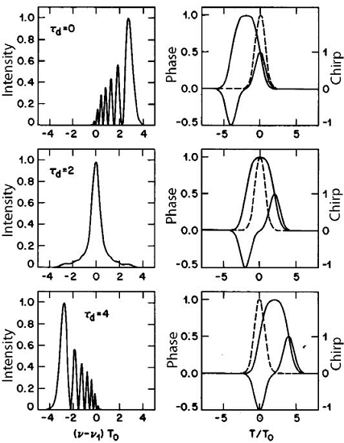
Asymmetric Spectral Broadening
The pump pulse travels faster than the probe pulse (δ < 0) and is delayed initially.
For τ_{d} = 0, the chirp is positive across the entire probe pulse, and the maximum chirp occurs at the pulse center.
When τd = 2, the pump pulse has time not only to the catch up but pass through the probe pulse in a symmetric manner.
When τ_{d} = 4, the pump pulse just catches up with the probe pulse at the ﬁber output. Its leading edge interacts with the probe; the chirp is therefore negative and the spectrum is shifted toward red.

Slide 54






Asymmetric Temporal Changes
If L_{D} becomes comparable to L or the walk-off length L_{W}, the combined effects of XPM, SPM, and GVD can lead to qualitatively new temporal changes that accompany the spectral changes discussed earlier. The coupled amplitude equations can be in the form
Where
If we assume |U₂|<< |U₁|, evolution of the pump pulse is then unaffected by the probe pulse. Evolution of the probe pulse is, however, affected considerably by the presence of the pump pulse because of XPM.

Slide 55
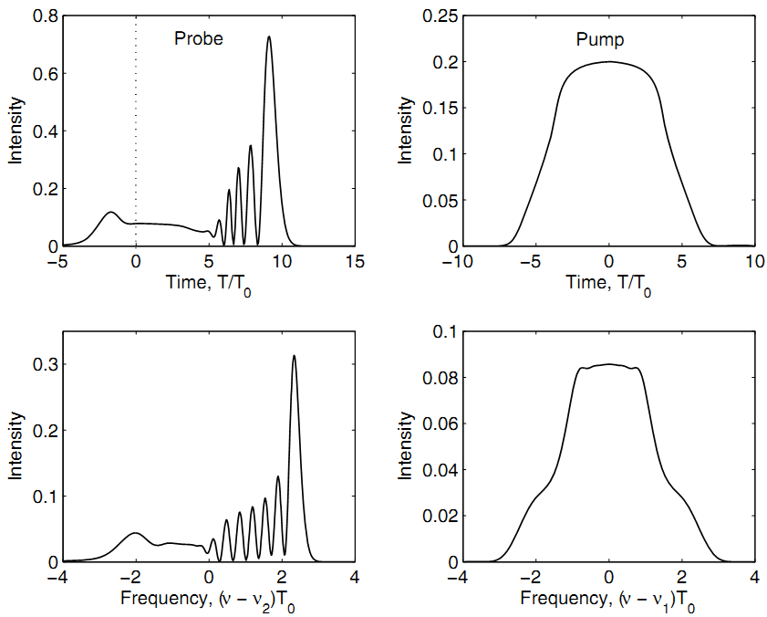



Asymmetric Temporal Changes
Effects from XPM & GVD
Effects from SPM & GVD

Slide 56
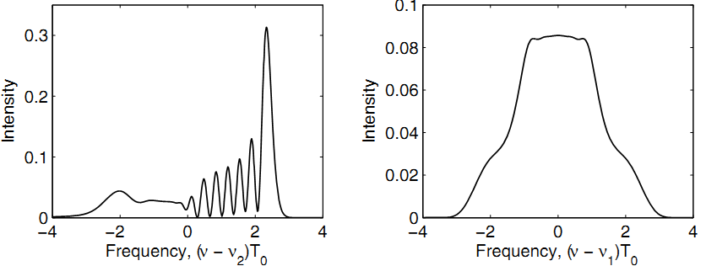
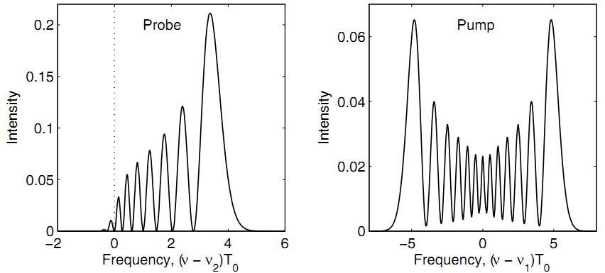
Asymmetric Temporal Changes
If GVD is absent…

Slide 57
Asymmetric Temporal Changes
In the absence of GVD, the pulse shape remains unchanged as XPM only affects the optical phase.
When GVD is present, different parts of the probe pulse propagate at different speeds because of the XPM-induced chirp imposed on the probe pulse. This results in an asymmetric shape with considerable structure.
XPM-induced chirp is maximum at the pulse center, and the combined effect of frequency chirp and positive GVD is to slow down the peak of the probe pulse with respect to its tails.
The XPM-induced optical wave breaking occurs because the peak lags behind and interferes with the trailing edge, noting that the faster moving pump pulse interacts mainly with the trailing edge of the probe pulse. If the probe and pump wavelengths were reversed, oscillations would develop near the leading edge.
The experimental observation of the XPM-induced asymmetric temporal effects requires L_{D}~L_{W} , therefore femtosecond pulses are needed.

